Slide 1
Contour Intervals

Slide 2
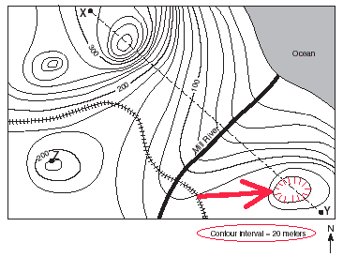
What is a contour interval?
The difference in elevation between two contour lines that are side by side.

Slide 3
How can we determine the contour interval?
Sometimes the map tells you!

Slide 4
How can we determine the contour interval?
By seeing how much the numbers increase by
This interval is 10, because each contour line is increasing by 10.

Slide 5
How can we determine the contour interval?
If not every line is numbered, you will need to look for patterns.
What do you think the contour interval is?
The correct answer is 100. Each contour line increases by 100.
There are index contours – 100 and 500. That means each line in between must be increasing by 100.

