Slide 1
Stream Surveys

Slide 2
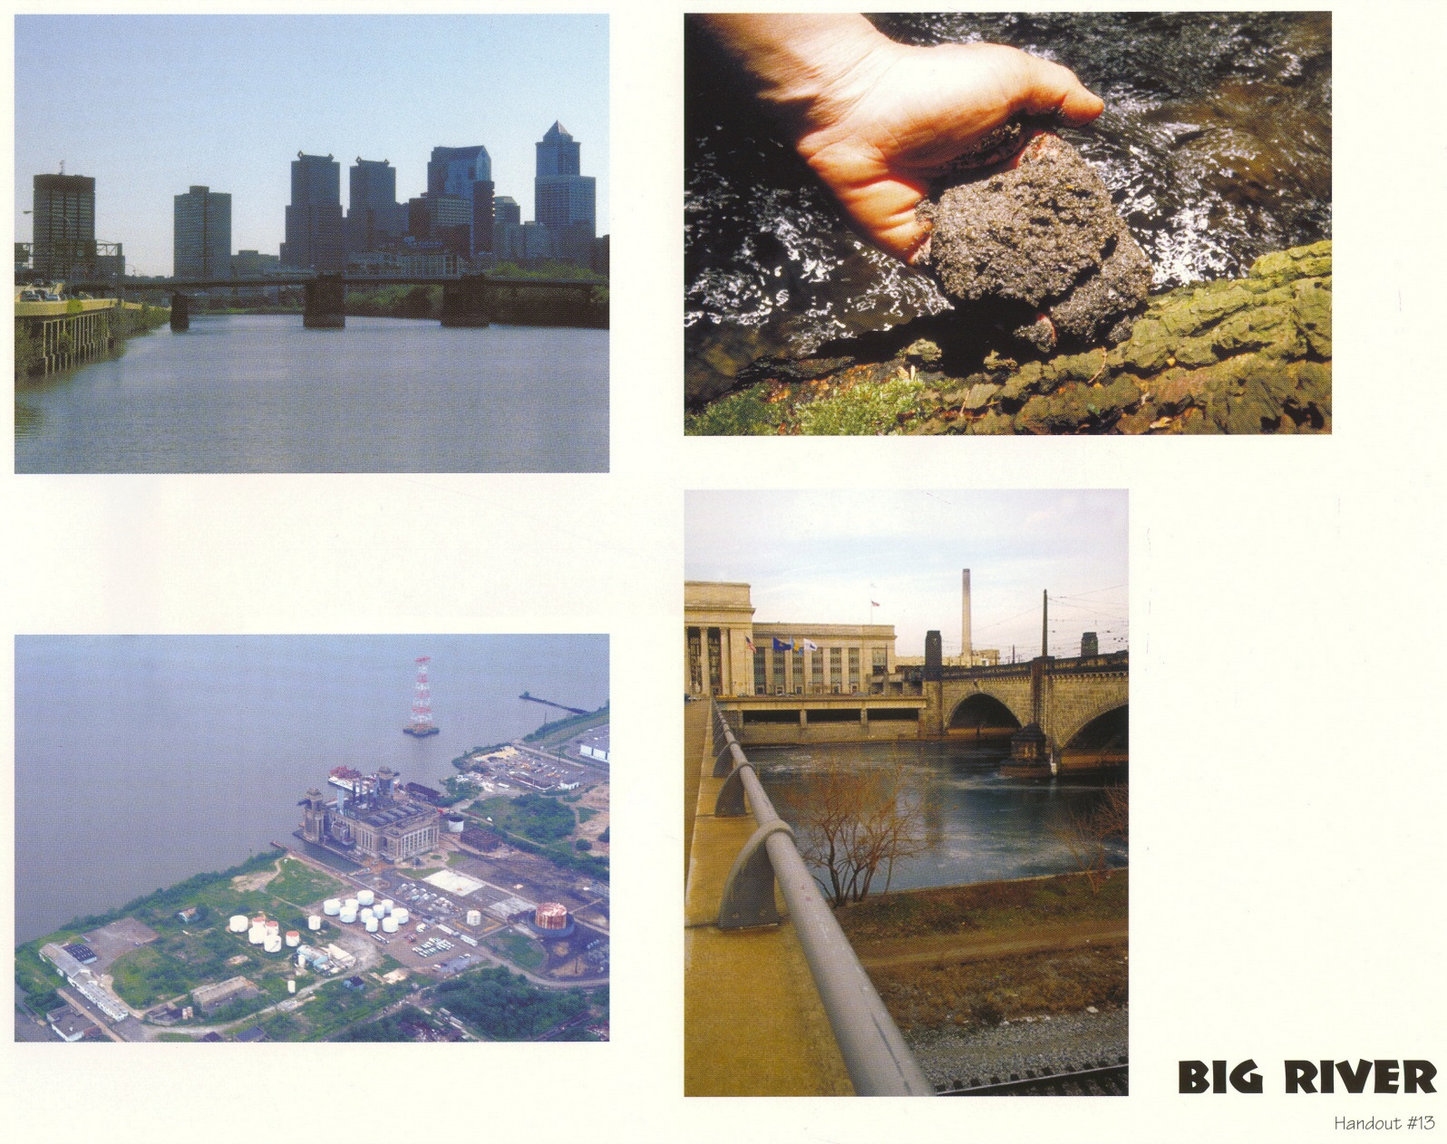
Big River
Complete a stream survey.

Slide 3
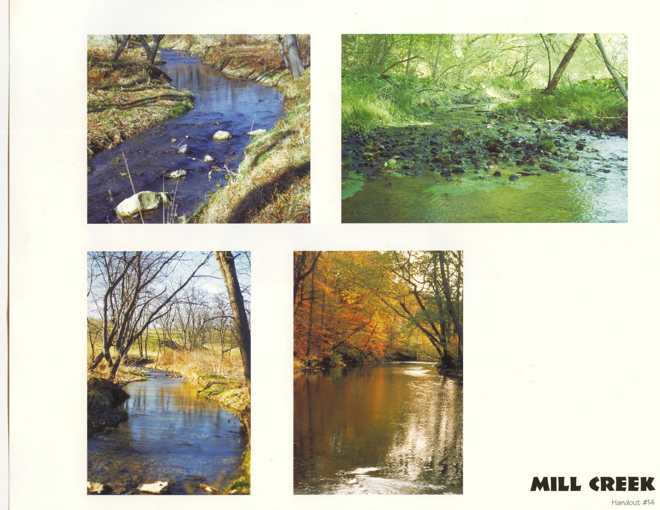
Mill Creek
Complete a stream survey.

Slide 4
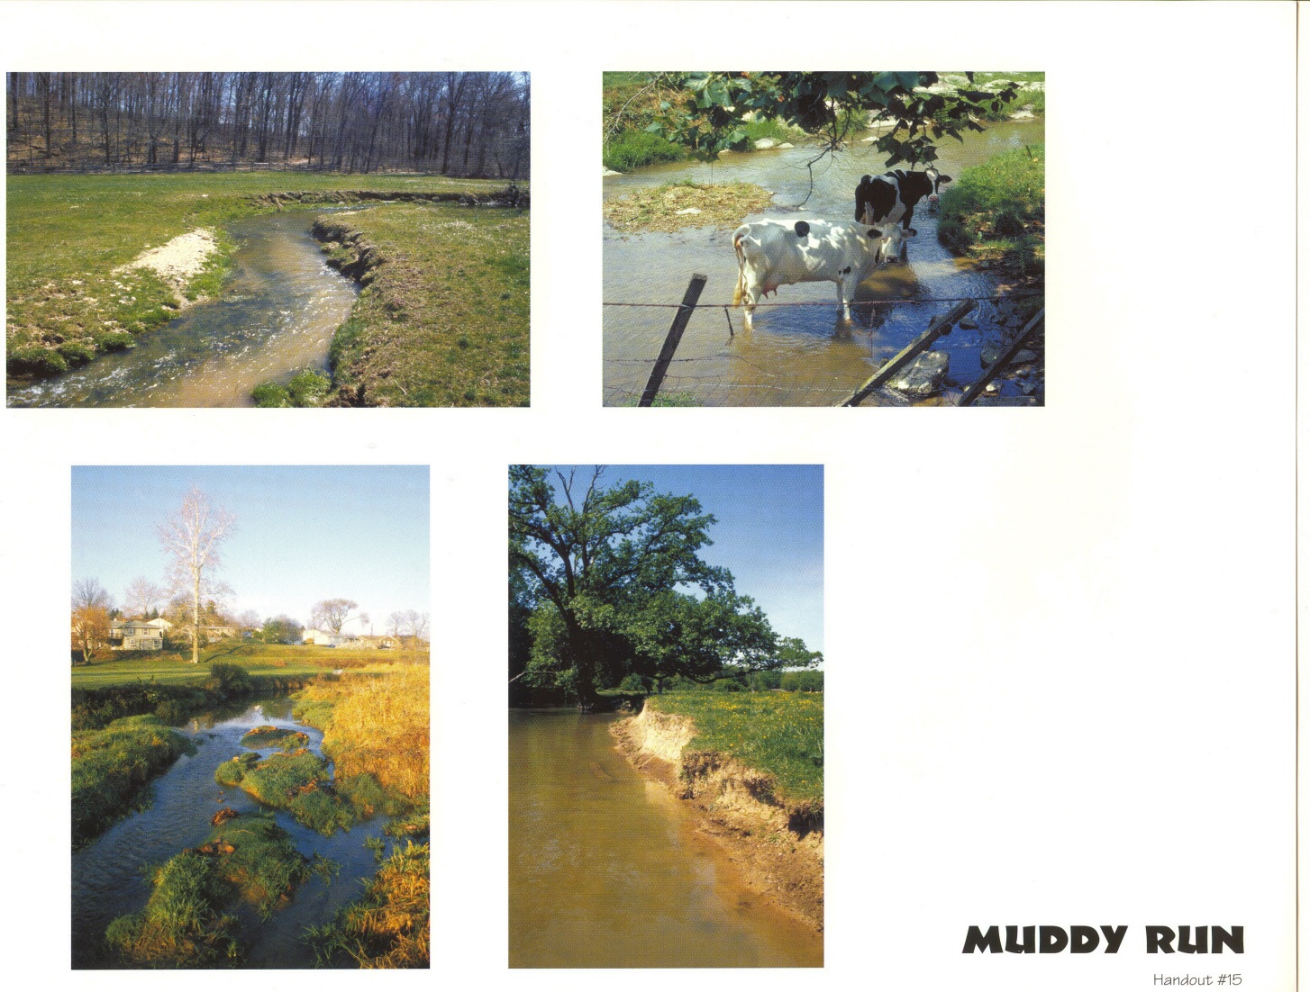
Muddy Run
Complete a stream survey.

Slide 5
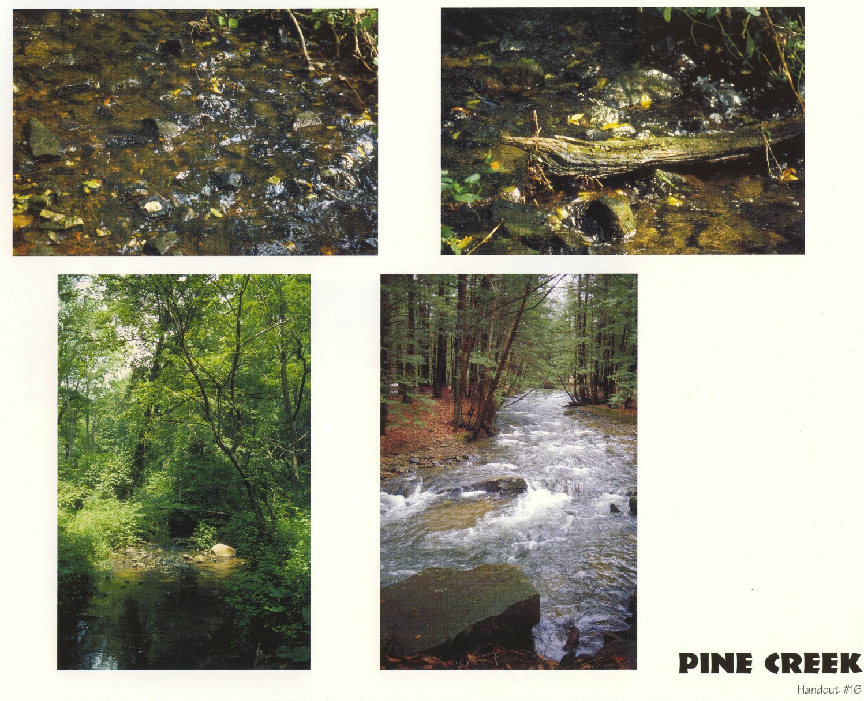
Pine Creek
Complete a stream survey.

